Slide 1

Do winter cover crops suppress weeds in Midwestern corn- and soybean-based systems? A meta-analysis
Andrea Basche¹, David Weisberger², Virginia Nichols², Alisha Bower³, Chris Wilbeck³, Sarah Carlson³
1. University of Nebraska-Lincoln, Department of Agronomy and Horticulture, Lincoln, NE
2. Iowa State University, Department of Agronomy, Ames, IA
3. Practical Farmers of Iowa, Ames, IA
Notes:
Thanks for joining this morning. Pleased to share a little bit about a project I’ve been working on with several collaborators about cover crops and weed control

Slide 2
Project background and rationale
The Corn Belt
Dominant C-S cropping systems
Highly productive WITH issues (soil erosion, water quality)
CCs effective in addressing these BUT…
What is the potential for cover crops to reduce weeds given cropping system constraints?
Notes:
We want to answer this question about how well cover crops suppress weeds and we are looking specifically at the CB because
The Midwestern Corn Belt is different than other places corn and soy are grown in the SE or MidAtlantic states – we grow fairly consistently the largest number of corn acres & represents about 80% of national production of corn and soybean
And in many of the CB states the overwhelming major of cropped acres are these two summer annual crops
Highly productive region – no doubt, but that has come at the cost of continued soil and water quality degradation- surface water q in Toledo oh or Des Moines or groundwater nitrate pollution in NE
Not going to say more about that other than cc can close the fall/winter/spring bare soil window BUT what is that impact on weeds. Can cc’s offset herbicide costs and improve short term economics for producers
We think this is a super important question for our region / environment / climate–so what can cover crops do based on what the data says given the limited heat units available in that fall window– hypothesize that we can cut costs – farmers tell us this
Recent paper came out – mention that they found that cover crops can control early season weeds – but that was not specific to the Corn Belt

Slide 3
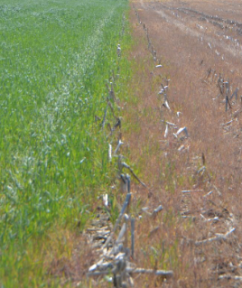
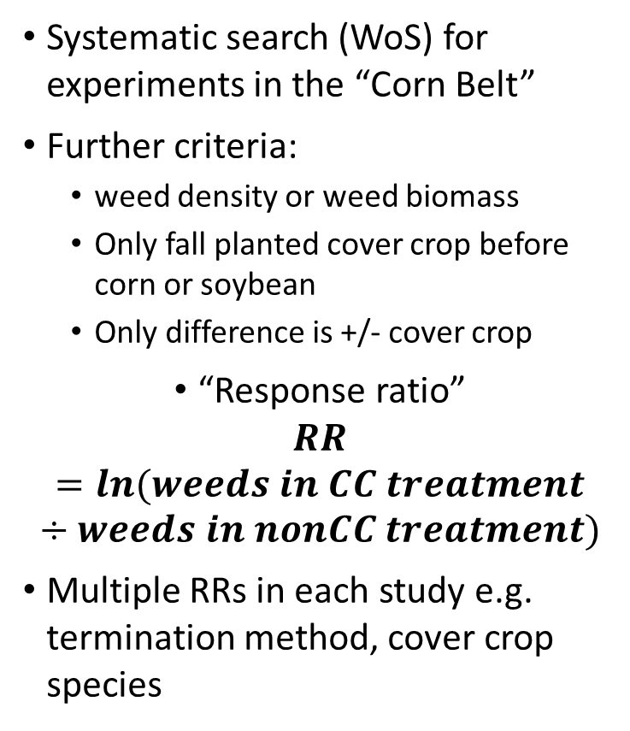
Methods
Systematic search (WoS) for experiments in the “Corn Belt”
Further criteria:
weed density or weed biomass
Only fall planted cover crop before corn or soybean
Only difference is +/- cover crop
“Response ratio”
$$RR=ln(weeds in CC treatment÷weeds in nonCC treatment)$$
Multiple RRs in each study e.g. termination method, cover crop species
Cover crop
No cover crop
Notes:
-Searched WOS for studies in the CB – let me go through our either criteria that collected weed biomass or weed density –
fall planted CC, before corn or soy, Photo meant to illustrate that the only difference in the RRs is the presence of a cover crop
Create a ratio – key unit we’re investigating in analysis like this – really the equalizer
Equation is the weeds w/ cc divided by no cc – and that would be the ONLY difference in all of our studies – control is no cover crop
Most studies looked at a few diff trts which leads to more RRs

Slide 4
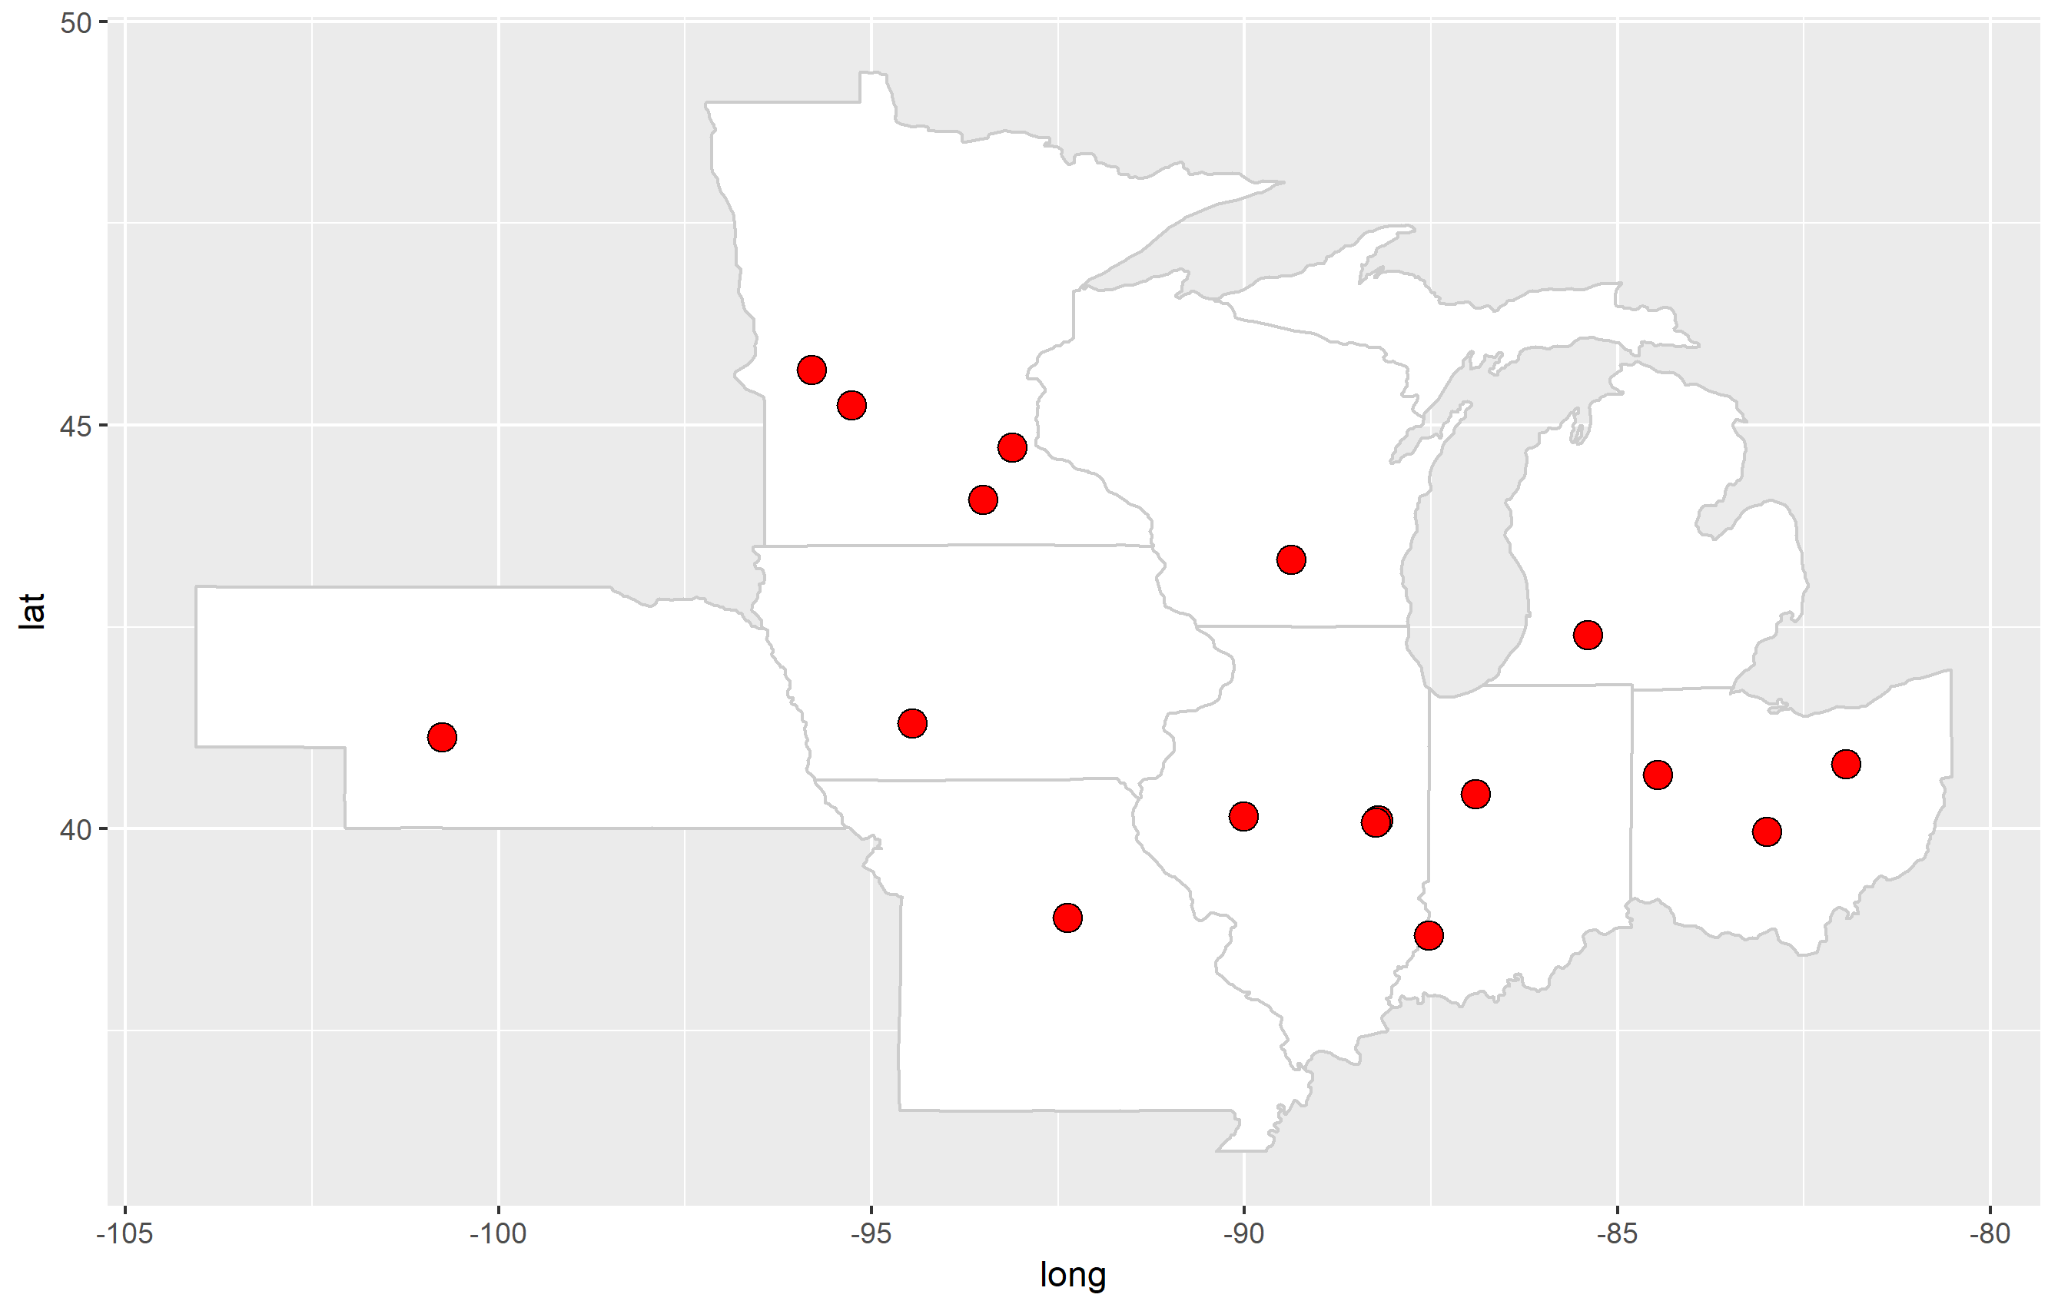
Screened 665 potential studies and have included 15 in a database for this preliminary analysis
*Corn Belt = Illinois, Indiana, Iowa, Kansas, Michigan, Minnesota, Missouri, Nebraska, North Dakota, Ohio, South Dakota, and Wisconsin
Notes:
From the keyword search we have included 15 studies across CB, and We have about another 20 potential studies from the keyword search that we need to finish screening
Have a few candidate studies for KS, have not found any in the Dakotas
Database very like to change and grow but excited to share what we’ve found up to this point in our analysis

Slide 5

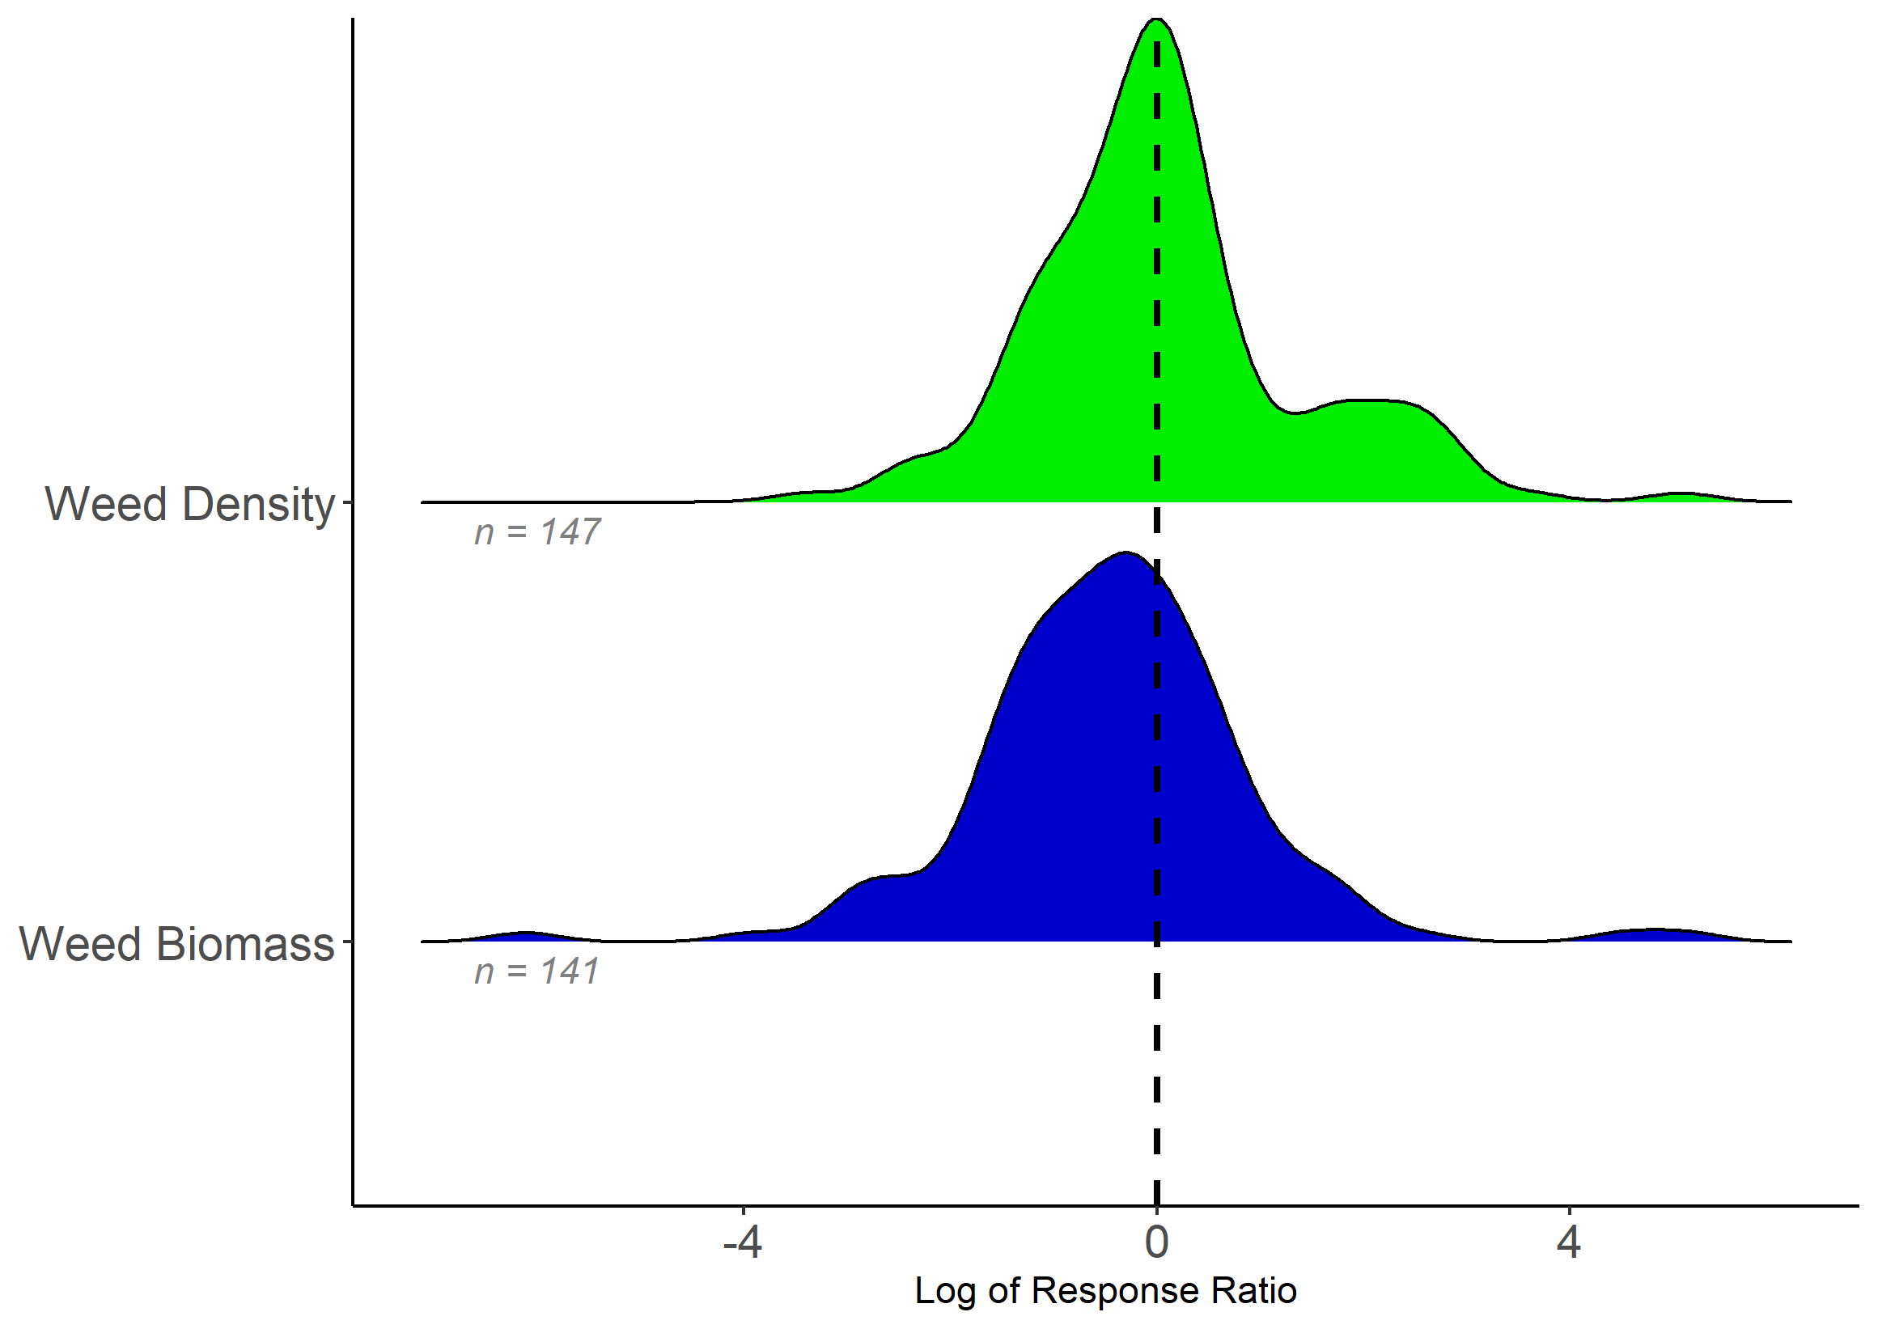
$$Log response ratio=natural log(weeds w/ cover crop÷weeds w/out cover crop)$$
Decrease in weeds
Increase in weeds
48% of RRs decrease weeds
64% of RRs decrease weeds
Notes:
Let me describe what you’re looking at here
This is the overall distribution of response ratios – again the ratio is the weeds measured – either biomass or density – in the cover crop trt divided by no cover crop treatment
So (animate arrows) if the weeds in cc were in the numerator and they were lower than we would have a RR below zero. If weeds in the cc trt were greater than there would be a value above zero
Overall what we found is that in 48% of RRs there was a decrease in weed density w/ cc
And in 64% of the RRs there was decrease in weed biomass w/ cc
So what does that mean? It means that the glass is either half full or half empty – what can *we* learn from this about when the glass was more empty, so that we can more consistently have it be full?

Slide 6
Summary
More work is needed to increase the efficacy of cover crops to control weeds!
What explains glass half-full vs. half empty?
Sufficient GDDs -> biomass
Termination method
CC species used
What about yield/weed suppression trade-offs?
Visit Poster 1137 to learn more and share ideas from 4-6pm this afternoon
Notes:
Quickly to wrap up: Its clear from the published literature that we haven’t figured out how cover crops can reduce weeds to offset costs in the MW systems - This is a call to action for us as researchers- farmers are seeing this anecdotally so how can we support it with the research
Learn more at the poster – noted a few things we’ve noticed that the poster has more detail on some of these questions – about amt of biomass, termination method differences, species, and some on the yield tradeoffs
Extra notes:
How would density plot look diff if separated by crop – if its just soybean then it could be explained by heat units
Could be about germination timing of weeds
Are pre emergence / or post emergence residual herbicides less effective? Were weed increases a result of a particular herbicide system.
Farmers also say that see increased weeds.
Maybe a more favorable seed bed for weeds
Tillage could explain more weeds – turning over more seed weeds / increase weed germination – note that none of our studies used tillage to terminate the cover crop
Mowing could also be responsible for a more favorable seed bed – maybe DeBruin mowed too early
Notes: REVIEW ARTICLE – only three are the same, their focus was timing (early season – figs broken out this way, only 30% were herbicide termination methods)
Why do cover crops increase weeds? Perhaps they are making soil more favorable.. Or tillage is turning over weed seeds – note that we do not have any tillage studies. They are all either mowing or crimping. Are they reducing the efficacy of some herbicides?
What is the critical threshold of biomass?
How many organic systems do we have and are there differences?
Is it really biomass? Bc the herbicide is less effective? Or did mowing make weed germination better?

Slide 7
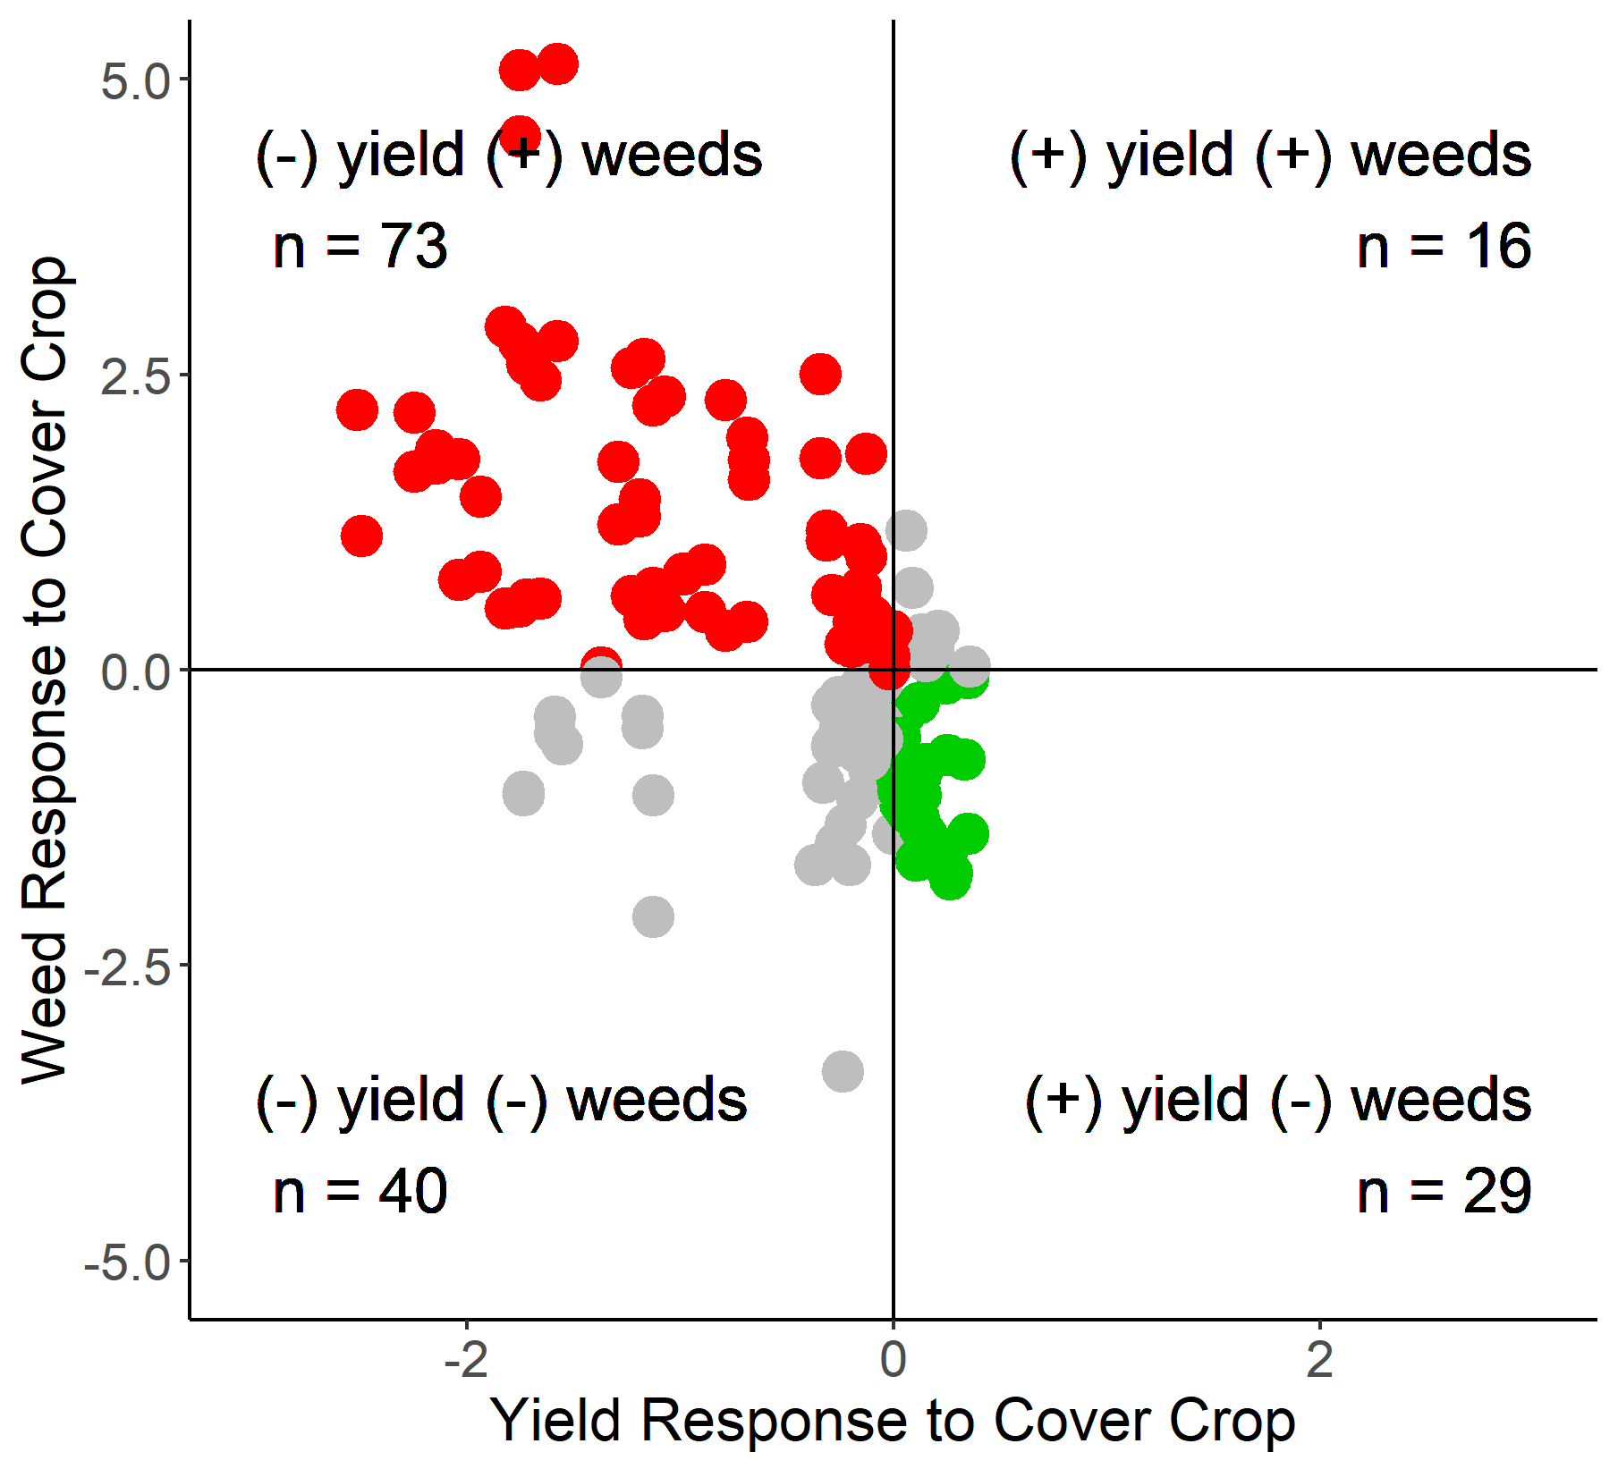
Lose Lose
46%
Andrea is going to figure out if she has time to include this in the five mins…
Increase weeds
Win Win
18%
Decrease weeds
Decrease yield
Increase yield
Notes:
Let me just add a little more complexity to the story before I run out of time
Some of the expts reported yields. And we looked similarly at crop yields as a ratio – so that’s what you’re looking at here on the x axis, so (animate arrows) if there is a value above 1 that means the cc increased yields, and if there is a value below they decreased yields
And we’ve plotted the weed response (both den and bio) on the y axis
This is a neat little trick because it allows us to look at the best case scenario – where cc decreased weeds and increased yields – which was 18% of the RRs
AND also, where cc increased weeds and decreased yields, so the least favorable outcome, and that was 46% of the RRs
So what can we learn from this so that more fall into the lower quadrant…. ?

